Slide 1
Employee Attrition
Presenter: Huang Jia

Slide 2
Employee Attrition
Data from: Employee Attrition Data set from Kaggle
What Is ‘Employee Attrition’?
Why is it important to understand ‘Employee Attrition’ rate?
Take a glance at the ‘IBM HR Analytics Employee Attrition’ dataset
Zoom in to some important reasons that affects the Employee Attrition Rate.
Job Level
YearsInCurrentRole
MonthlyIncome
Age

Slide 3

What is Employee Attrition?
Reduction in the number of employees in the company.
Employee leaves the company, organization has to look for a replacement

Slide 4
‘Examine the reasons that contributes to ATTRITION’

Slide 5
Why is it important to understand ‘Employee Attrition’ rate?
Identify the what are the contributing reason for employee to leave
Expensive and time consuming to train a new talent
More cost effective to keep the people the company have
Come up with solutions to retain employees from leaving

Slide 6
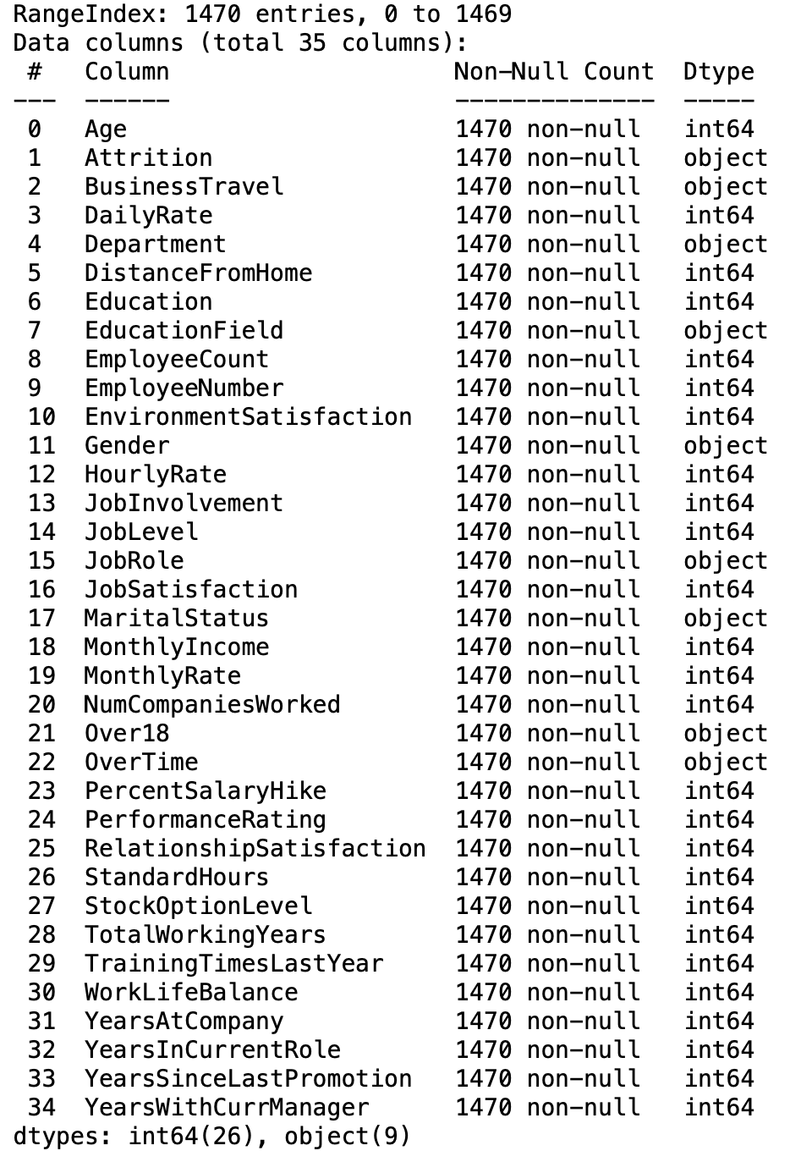
Take a Glance
Variables for the Data set
From this data
There are 1470 rows and 35 columns (1470 employee data, 35 Variables)
There are no Null-Values
There are 26 (Int64), 9 (Object)

Slide 7
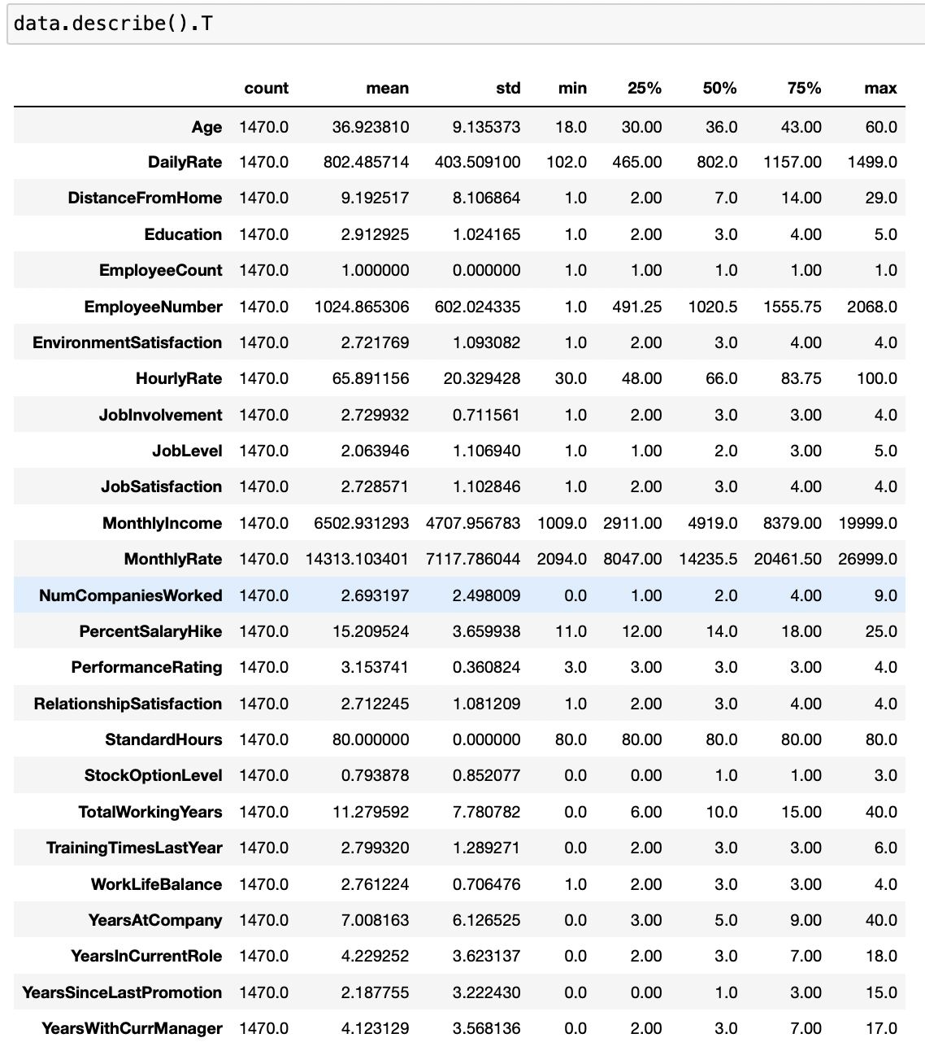
A Glance at the basic info

Slide 8
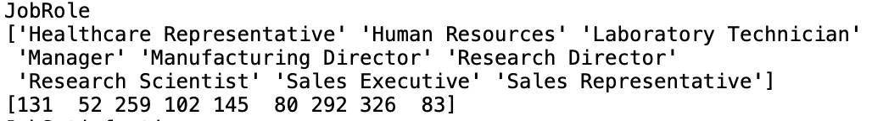








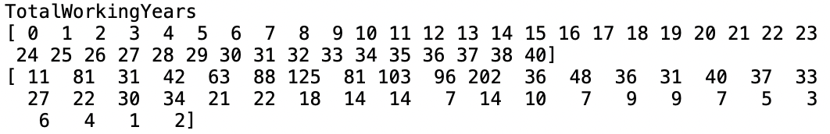

Drop the columns

Slide 9
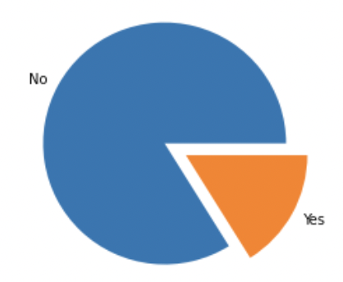

‘Attrition’
1233 people staying in the company
237 people leaving the company

Slide 10
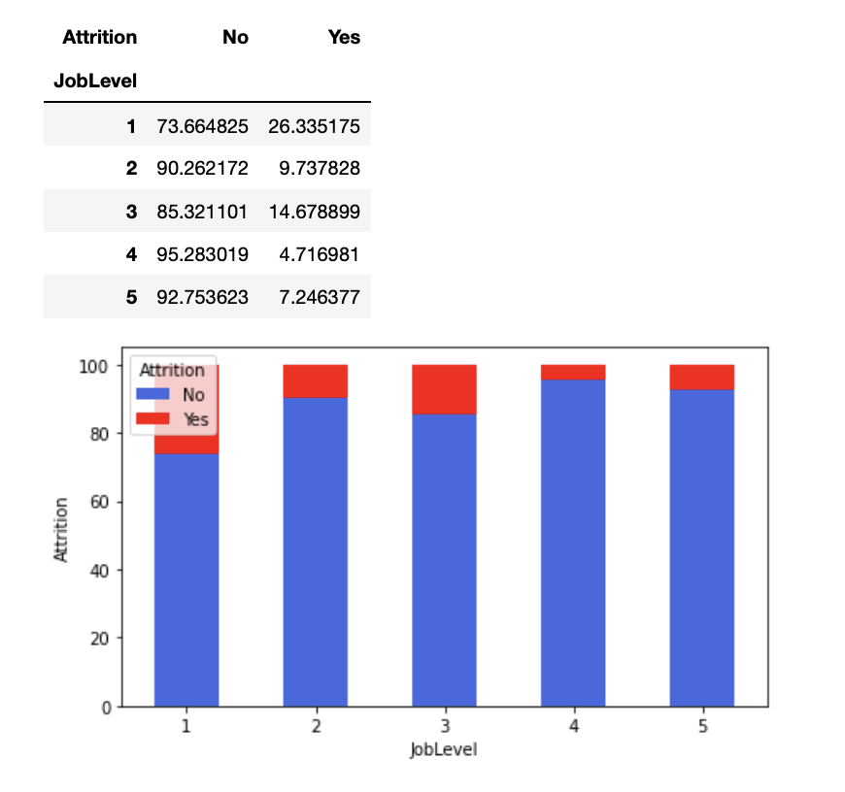
Job Level

Slide 11
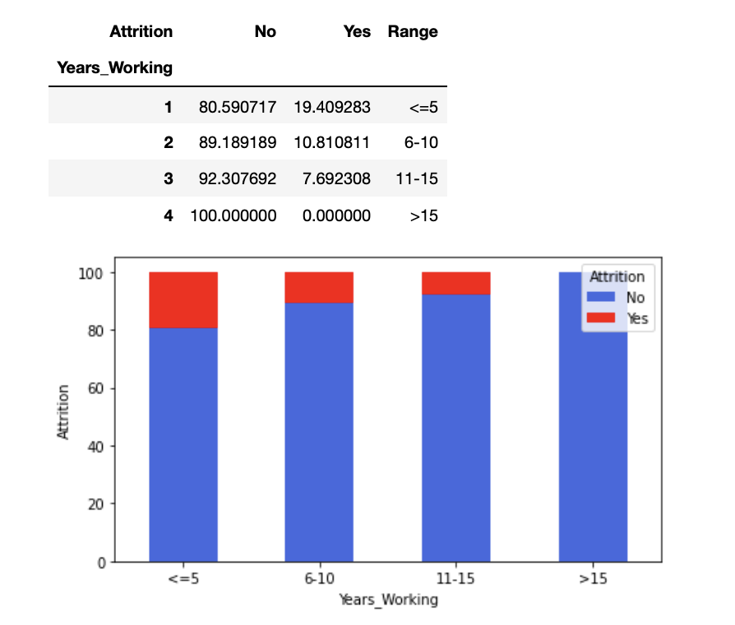
Years At Current Role

Slide 12
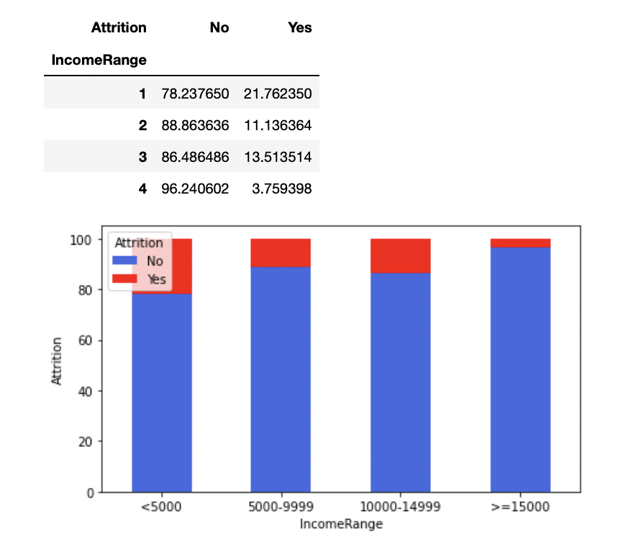
Monthly Income

Slide 13
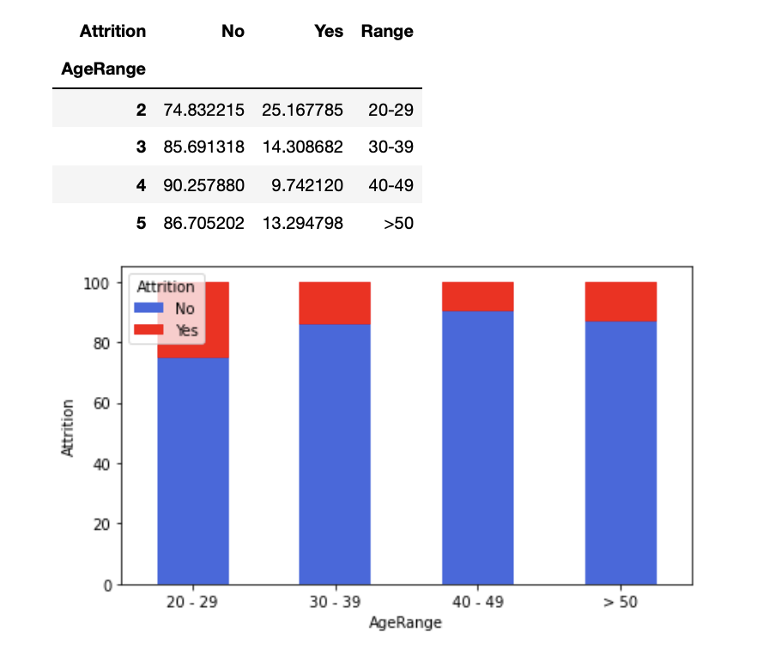
Age

Slide 14
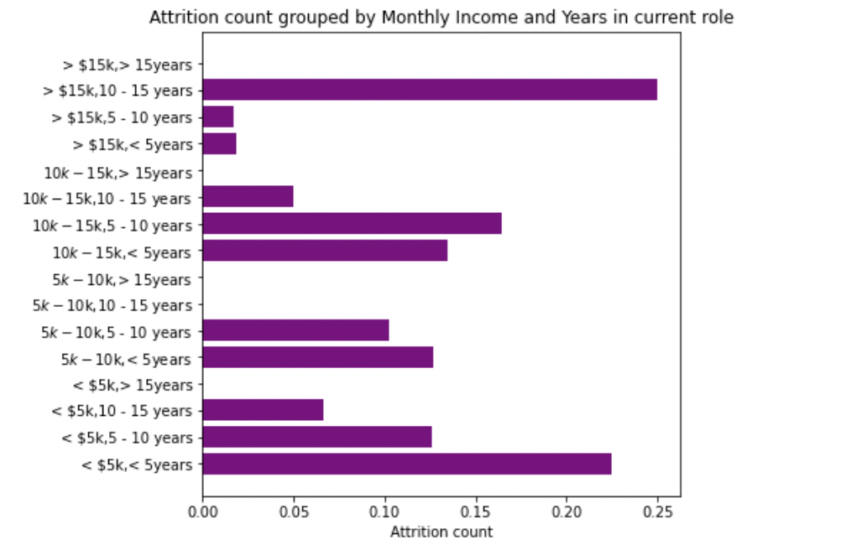
Relatively people who has higher pay
will not leave the company,
and they stayed longer in the company

Slide 15
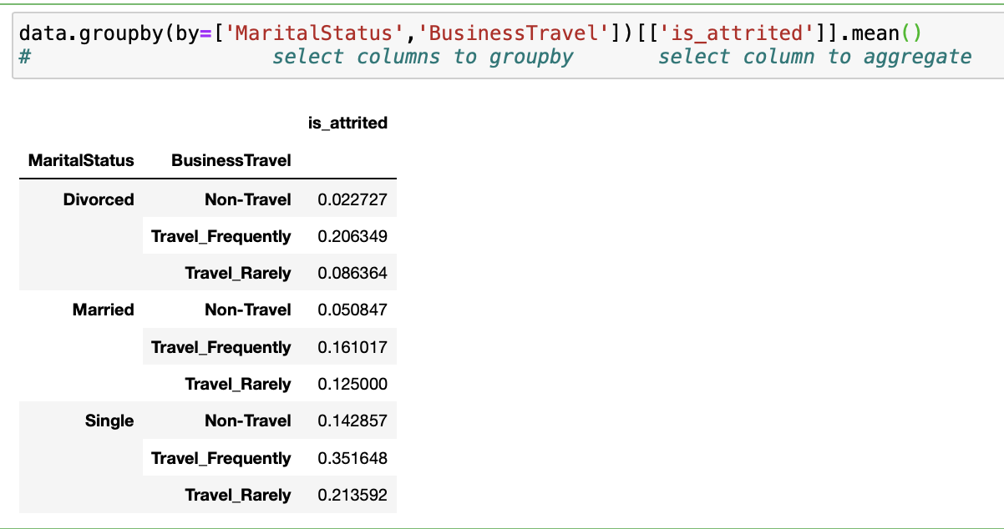
35% left are Single & Travel Frequently
16% stayed are Married & Travel Frequently

Slide 16

Conclusion
1. Hire the right people
2. Keep compensation and benefits current
3. Recognize and reward employees
4. Pay attention to engagement
5. Make opportunities for development and growth

Slide 17
Q & A

Slide 18
Thank You
: )

